Slide 1
As valuable as it
is beautiful
Applicable to designers,
and developers
The 8 STAGES of
Psychosocial
Development Virtues, Battles, and Examples
Sean Patrick John Paul George Ringo Doran
@spjpgrd
Performs double duty as
design and life advice
There’s nothing
quite like it

Slide 4
Do Me a Favor…
Keep that in mind

Slide 5
Do Me a Favor…
Keep that in mind

Slide 6
So, before we get the 8 Steps…

Slide 7
I want you to look at three concepts…

Slide 8
Why?

Slide 9
three reasons…

Slide 10
Context
Application
Methodology

Slide 11
How to Read a Book:
The Classic Guide to Intelligent Reading

Slide 12
Coming to terms

Slide 13
Let’s do this thing

Slide 14





volume 1 the timeless way of building
volume 2 a pattern language
volume 3 the oregon experiment
Center for Environmental Structure
berkeley, california
The
Timeless Way
Of Building
Christopher Alexander
with love and thanks
to Ingrid, Sara, and Peter
New York
Oxford University Press
1979
The Timeless Way of Building is the first in a series of books which describe an entirely new attitude to architecture and planning. The books are intended to provide a complete working alternative to our present ideas about architecture, building, and planning–an alternative which will, we hope, gradually replace current ideas and practices.

Slide 15
The action and the space are indivisible.

Slide 16
The action and the space are indivisible.

Slide 17
The action is supported by this kind of space.

Slide 18
The space supports this kind of action.

Slide 19
The two form a unit, a pattern of events in space.

Slide 21
So let’s get back to you for our second concept…

Slide 22
You see, before you were born…

Slide 23
You see, before you were born…
Abilities
Prenatal Care
Genetics

Slide 24
So before a someone uses your product
for the first time…

Slide 25
Introducing Dr. BJ Fogg and his Behavioral Model
Ability
Action
(in a space)
Trigger
Facilitator
Spark
Signal
Motivation
Sensation
Anticipation
Social Cohesion

Slide 26
And hidden over here is your third concept…

Slide 27

Activity
Centered
Design

Slide 28


Activity
Centered
Design
Just do it

Slide 29

Activity
Centered
Design
Just do it
Centered around it
Subjects
Rules/Rituals
Community
Artifacts
Object
Division of Effort
Outcome

Slide 30

Activity
Centered
Design
Just do it
Centered around it
How it works
Subjects
Rules/Rituals
Community
Artifacts
Object
Division of Effort
Outcome
Motivation

Slide 31
Recapitulation
Alexander’s Action & Space

Slide 32
Recapitulation
Alexander’s Action & Space
Fogg’s Behavioral Model

Slide 33
Recapitulation
Alexander’s Action & Space
Fogg’s Behavioral Model
Activity Centered Design

Slide 34
The 8 STAGES of
Psychosocial
Development Virtues, Battles, and Examples
Sean Patrick John Paul George Ringo Doran
columbus
Stir Trek
2016

Slide 35
0–1
Infancy
Early Childhood
1–3
Pre-school Age
3–6
School Age
6–12
Adolescence
13–19
Early Adulthood
20–39
Adulthood
40–64
Maturity
65–Death

Slide 36
Infancy
Hope
Trust v. Mistrust

Slide 37
Early ChiLdhoOd
will
Autonomy v. Shame

Slide 38
Pre-School Age
Purpose
Initiative v. Guilt

Slide 39

School Age
Competency
Industry v. Inferiority

Slide 40
Adolescence
Fidelity
Ego Identity v. Role Confusion

Slide 41
Early Adulthood
LOVE
Intimacy v. Isolation

Slide 42
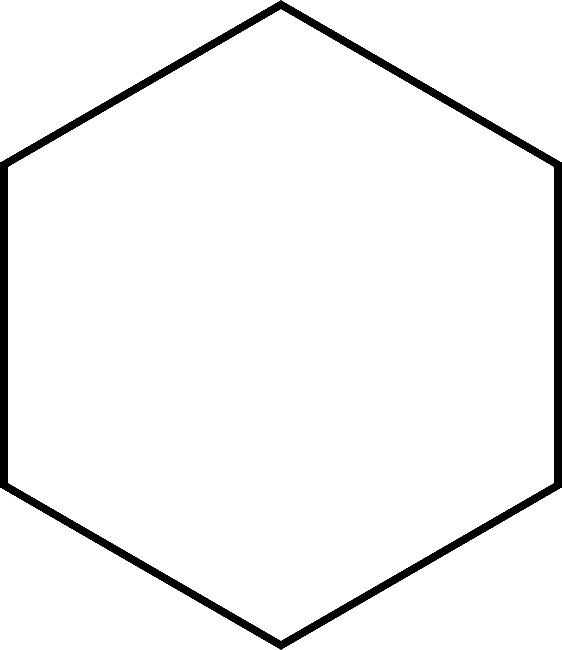
liking
intimacy
Romantic
intimacy
Companionate
intimacy + passion
commitment + intimacy
Consummate
passion
commitment
Infatuation
Empty
passion
commitment
FatUous
passion + commitment

Slide 43
Adulthood
Care
Generatively v. Stagnation

Slide 44
Maturity
Wisdom
Ego Integrity v. Despair

Slide 47
0–1
Infancy
Early Childhood
1–3
Pre-school Age
3–6
School Age
6–12
Adolescence
13–19
Early Adulthood
20–39
Adulthood
40–64
Maturity
65–Death

Slide 48
Thank You
Bryan Brush
David All
Don Chen
Hillary Hutchings
Kevin Mack
Laura Masters
Mark Krugman
Sam Bantner

Slide 49

Sean Doran
www.SPJPGRD.com • @spjpgrd

